Slide 1
World Book Day The Big Bonanza Quiz J.Herron

Slide 2
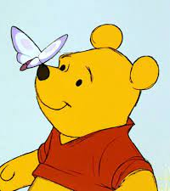
Question 1
Where do Winnie the Pooh, Piglet, Owl and Eeyore live?
The Hundred Acre Wood
The Faraway Tree
The Enchanted Wood

Slide 3
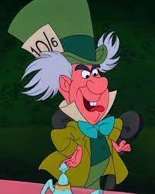
Question 2
In which book would you find the Mock Turtle, the Dormouse and the Madhatter?
The Moomins
Alice’s Adventures in Wonderland
The Wizard of Oz

Slide 4
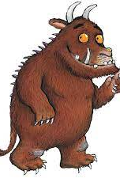
Question 3
Who illustrated The Gruffalo by Julia Donaldson?
Judith Kerr
Tony Ross
Axel Scheffler

Slide 5
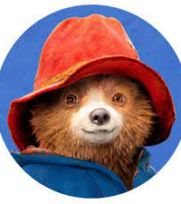
Question 4
What country does Paddington Bear originally come from?
Chile
Peru
Brazil

Slide 6
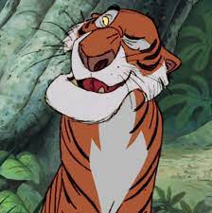
Question 5
In the Jungle Book by Rudyard Kipling, what is the name of the tiger?
Shere Khan
Baloo
Bagheera

Slide 7
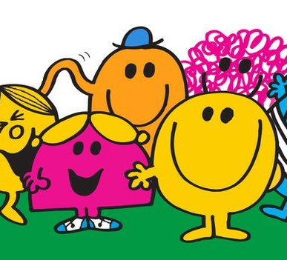
Question 6
What shape is Mr Strong in the Mr Men series?
A circle
A triangle
A square

Slide 8
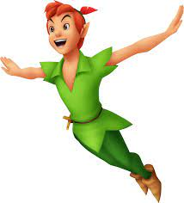
Question 7
In Peter Pan by J.M. Barrie, what is the name of the land where Peter and the Lost Boys live?
Narnia
Neverland
Lilliput

Slide 9
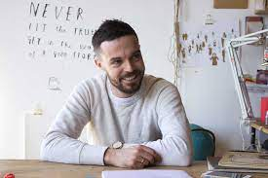
Question 8
What type of bird features in Oliver Jeffers’ book ‘Lost and Found?’
A duck
A puffin
A penguin

Slide 10
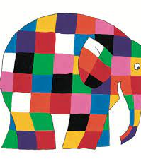
Question 9
What is the name of Elmer the Elephant’s black and white cousin?
Will
Wilbur
Wilfred

Slide 11
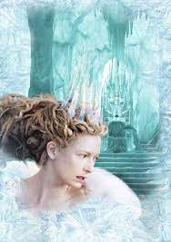
Question 10
What treat does the White Witch use to trick Edmund in The Lion, the Witch and the Wardrobe?
Chocolate
Turkish Delight
Ice-cream

Slide 12
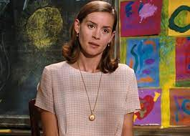
Question 11
What is the name of Matilda’s teacher?
Miss Syrup
Miss Nutella
Miss Honey

Slide 13
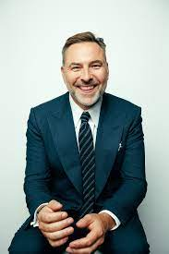
Question 12
Who wrote Gangsta Granny, The Stink and The Midnight Gang?
1. David Williams
2. David Walliams
3. Dave Walliams

Slide 14
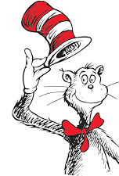
Question 13
In The Cat in the Hat, what type of pet does Sally have?
A dog
A cat
A fish

Slide 15
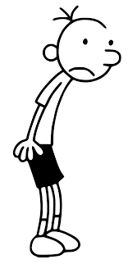
Question 14
In Diary of a Wimpy Kid, what’s the Wimpy Kid’s real name?
Greg Heffley
Tom Redgrave
Gavin Smith

Slide 16
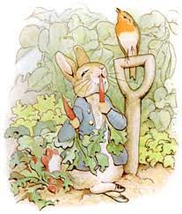
Question 15
Who wote the well-known children’s books, The Tale of Peter Rabbit, The Tale of Jemima Puddle-Duck and The Tale of Mrs Tiggy-Winkle?
1. Enid Blyton
2. Beatrix Potter
3. Julia Donaldson

Slide 17
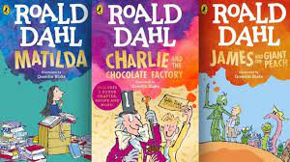
Question 16
Which Roald Dahl story features a character called Sophie?
Matilda
The Twits
The BFG

Slide 18
Answers
The Hundred Acre Wood
Alice’s Adventures in Wonderland
Axel Scheffler
Peru
Shere Khan
A square
Neverland
Wilbur
Turkish Delight
Miss Honey
David Walliams
A fish
Greg Heffley
Beatrix Potter
The BFG

