Slide 1
OUR JOURNEY IN PRIMARY 3

Slide 2
GENERAL INFORMATION
9.00 - Door opens and children come straight into their classroom
Collect children promptly at the end of each day
Monday 2.45pm
Tuesday, Wednesday & Thursday 2.15pm
Friday 1.40pm
School lunches booked for the week ahead using the School Money App

Slide 3
Literacy
Reading
-We will work on different reading strategies during guided reading sessions
- We will read a range of fiction and non-fiction books during whole class shared reading and guided reading
- We will focus on the development of comprehension skills throughout the year
Writing
-We will encourage all pupils to take pride in the presentation of their work and to use basic punctuation correctly
Talking and Listening
-We will encourage all pupils to develop their talking and listening skills throughout the year

Slide 4
PHONICS
Jolly Grammar
Our Primary 3 children will be following the ‘Jolly Grammar’ scheme. This is aimed at improving pupils’ spelling, punctuation and grammar. Additional information is available on the school website.

Slide 5
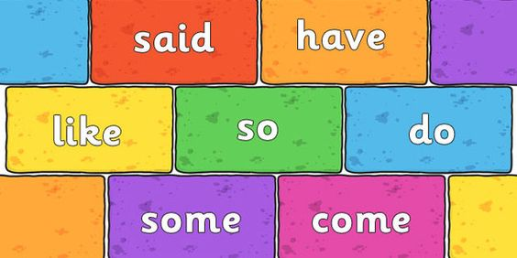
Tricky Words
SIGHT WORDS
We teach the first 150 sight words to build pupils’ reading fluency
TRICKY WORD SPELLING
We use a careful balance of phonics and tricky word spellings to improve pupils’ spelling skills
Phonics spellings and tricky words are assessed on a weekly basis
We encourage accurate spelling of tricky words in independent writing

Slide 6
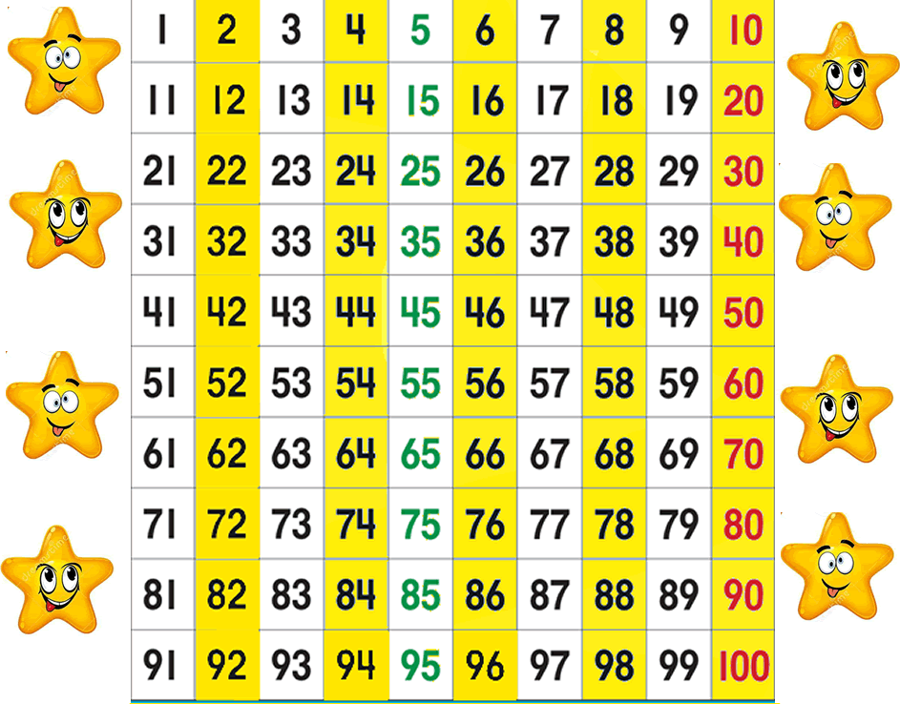
Numeracy
Mental Maths
We encourage quick recall of number facts
Number
Numbers to 100
Tens and units
Money to one pound
Counting patterns
Other
Time – o’clock, half past, quarter past
-Measure – introducing standard units of measure (metre, kilogram, litre)
2D and 3D shape
Investigations
Thinking Skills and Personal Capabilities
We use lots of practical materials when teaching new concepts to aid understanding

Slide 7
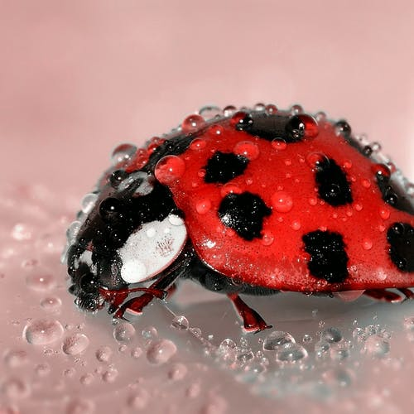
The World Around Us
Topics
Myself – bones, taste and sight
Birds – garden birds, birds of prey and penguins
Transport – transport through the ages, cars, aeroplanes, boats and Titanic
Houses and Homes – Past and Present and other countries
Minibeasts
Some of our topic sessions are taught through Forest school lessons / other outdoor learning opportunities

Slide 8
HOMEWORK
Written homework
Homework given out every Monday and returned every Thursday
-Written Literacy and Numeracy
-Topic related Seesaw Class activity
Please sign completed written homework
Spellings and Maths Facts
These are found in the red jotter
Reading
Reading books given out every Monday and returned every Thursday
-2 Guided reading books and 1 unseen book each week
-Online reading books allocated from Term 1B

Slide 9
Communication
The school office is open from 8.30-2.30 daily.
Enquiries can be sent to the class teacher via Seesaw and if necessary, an appointment can be made for a face to face meeting
Class teachers are available on Seesaw within school hours

Slide 10
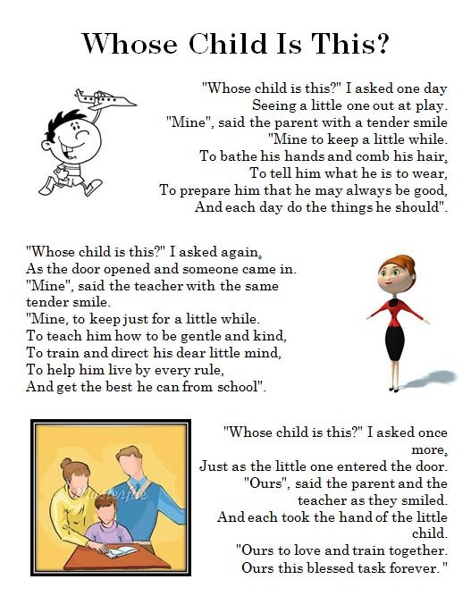
Teacher – Parent Partnership

